Slide 1


可编码超表面及其应用
报告人：于帅

Slide 2
可编程超表面
传统光学器件
原理：光波的折射、反射、衍射等基础光学理论
实现：通过光程的累积实现光相位的变化，实现工作波长段光的聚焦、成像、分束等工作。
光学超材料
新型人工超材料
具有奇特电磁特性的光学结构，如负折射、后向波传输、逆多普勒频移，可以利用空间相位累积调控电磁波的相位。
光学超表面
二维形式的人工超材料，一般由具有亚波长几何尺寸的基本单元周期性或非周期性排列组成。它们可以通过超薄电磁超表面两侧的相位和幅度的突变特性来调控电磁波的相位和幅度分布。

Slide 3
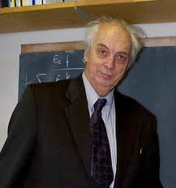
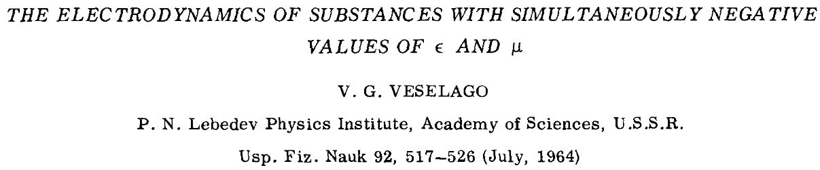

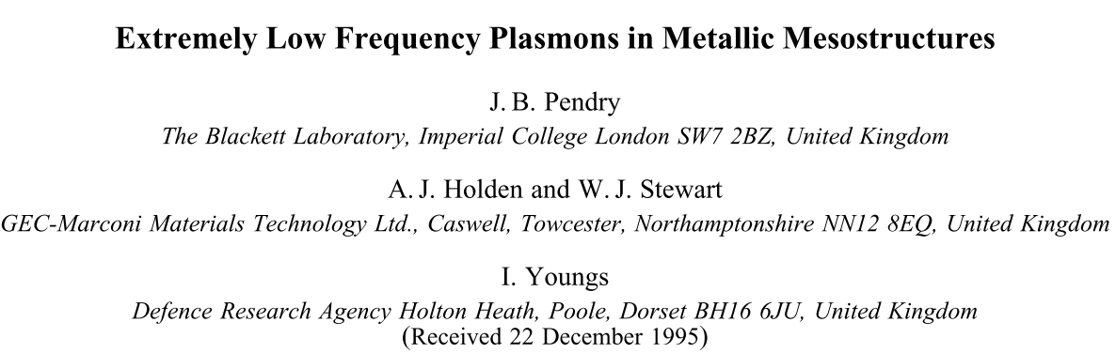
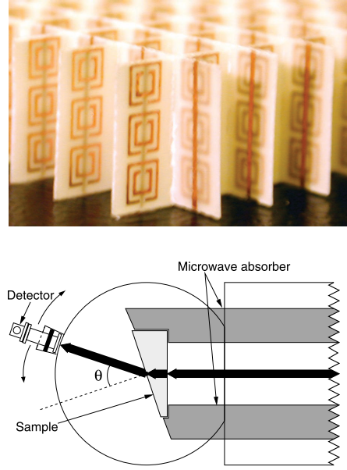
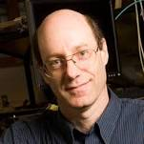
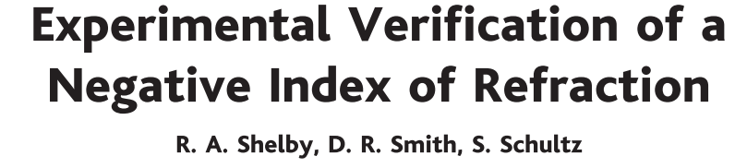
电磁超表面
负介电常数、磁导率 1968
[1]
周期性亚波长结构 1996
[2]
[3]
实验得到负折射率 2001

Slide 4
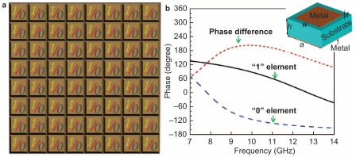
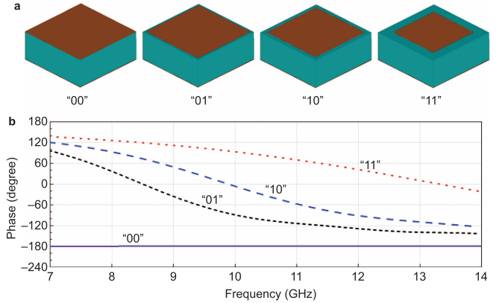
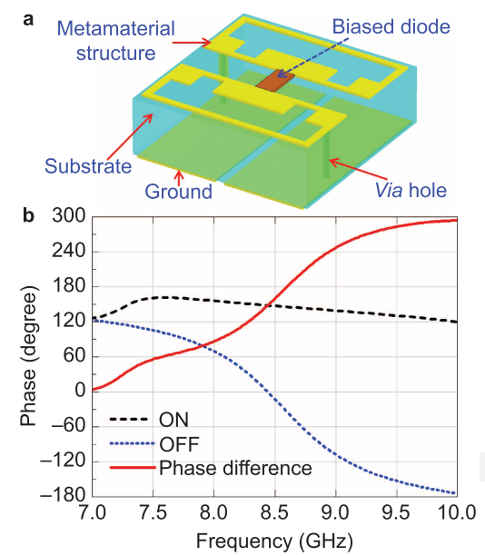
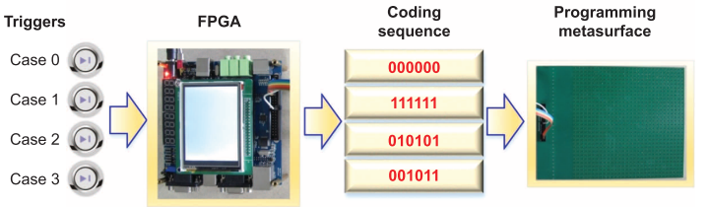
可编码超表面
[4]
2位编码超表面元素及其相位响应
超表面整体结构与单元设计
使用FPGA调控超表面编码

Slide 5
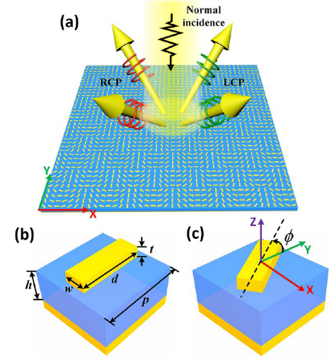
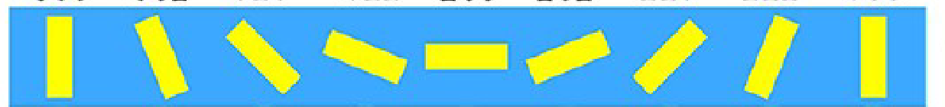
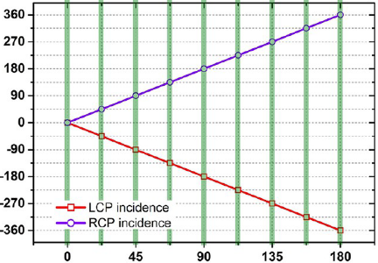
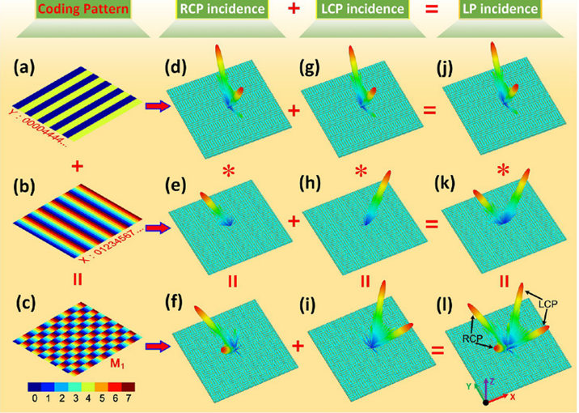
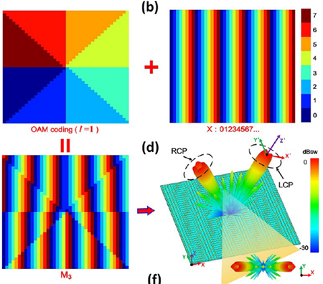
可编码超表面类型——P-B超表面
[5]
相移(°) | 0 | ±45 | ±90 | ±135 | ±180 | ±225 | ±270 | ±315
编码 | 000 | 001 | 010 | 011 | 100 | 101 | 110 | 111
OAM编码可以被描述：

Slide 6
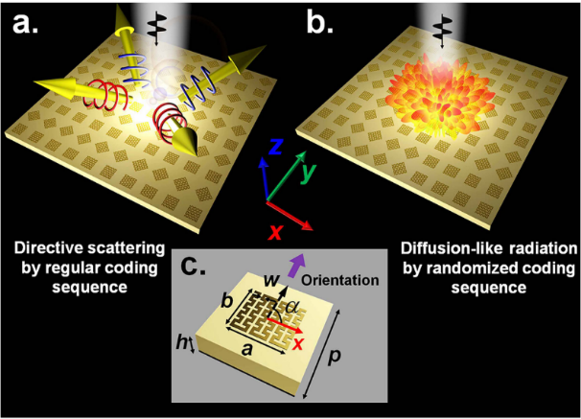
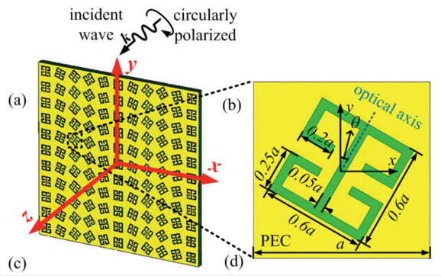
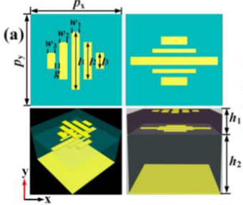
可编码超表面类型——P-B超表面
[6]
基于P-B超材料在宽频带（发生在13.5-21.5GHz）上获得类似漫散射的覆盖上半空间所有方向的反射效果（异常散射）
[7]
基于P-B超材料获得高效的异常折射和偏振控制的双功能
[8]
基于P-B超材料在6.95至18 GHz的宽带范围内生成宽带涡旋光束。

Slide 7
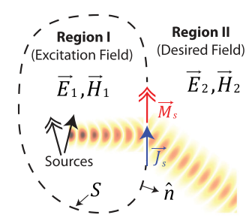
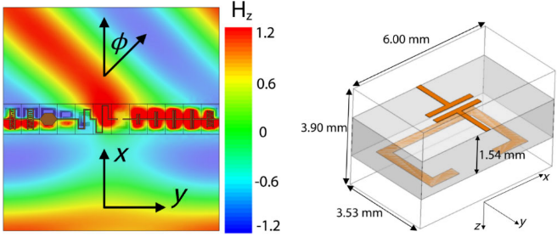
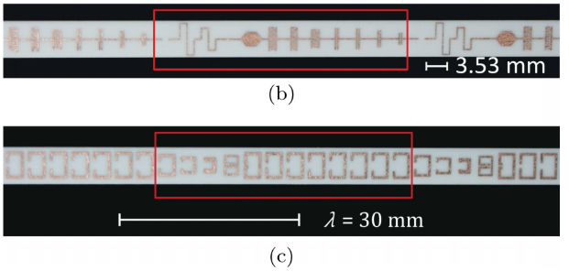
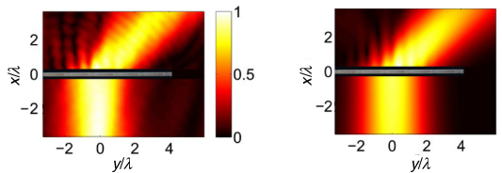
可编码超表面类型——Huygens超表面
[9]
设置表面电流来满足边界条件：
惠更斯超表面的主要优势：
可以将入射光束以接近100%的效率重新定向。

Slide 8
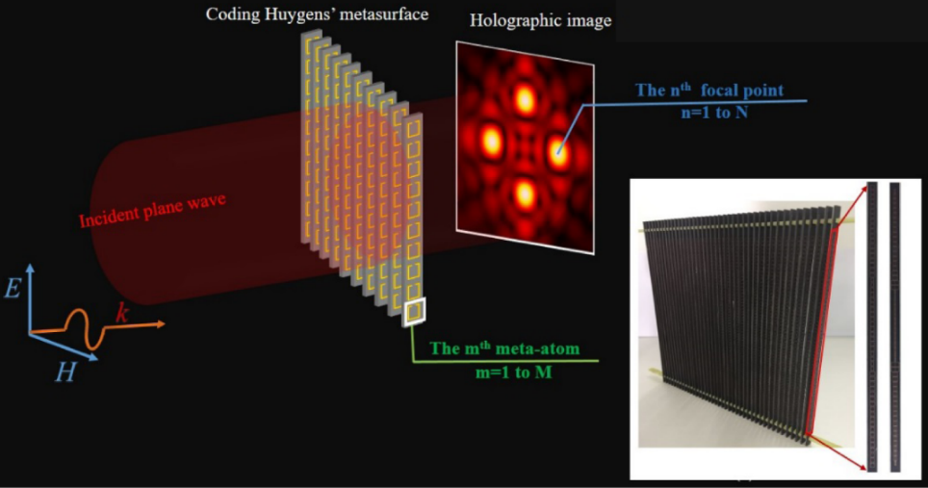
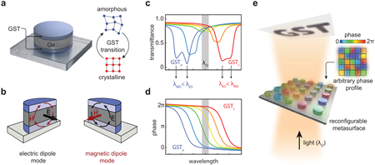
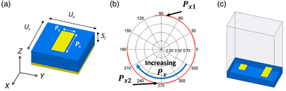
可编码超表面类型——Huygens超表面
[10]
编码惠更斯的亚表面用于全息成像的增强质量。
[11]
将相变材料在其非晶态和晶体结构态之间切换可实现几乎完整的动态光相位控制，并在中红外光谱中具有高透射率。
[12]
使用双组件惠更斯超表面可以在宽的角度和频率范围内实现完美的异常反射。

Slide 9
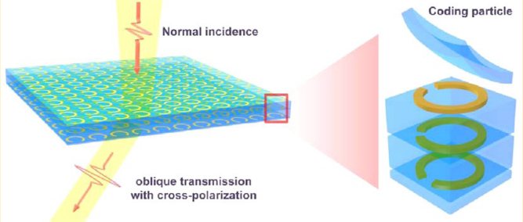
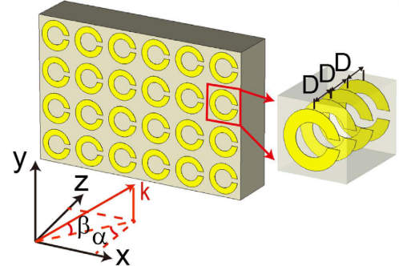
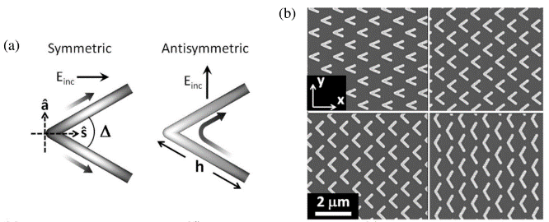
可编码超表面类型——固定各向异性单元
[13]
使正常入射的太赫兹光束在异常方向上弯曲，并在正常和倾斜方向上产生非衍射贝塞尔光束。
[14]
结合P-B超材料-C形超材料完成高效偏振分束器
[15]
结合P-B超材料-V形超材料完成多项光束调整功能

Slide 10
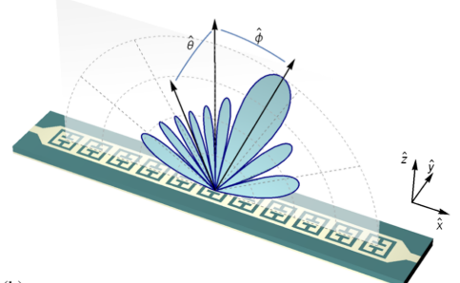
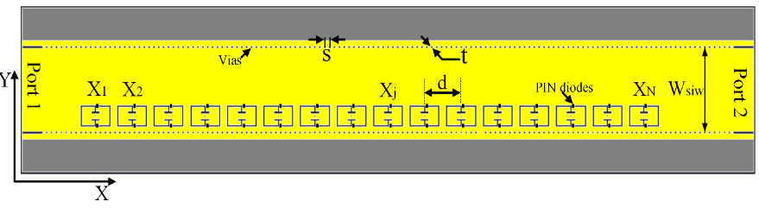
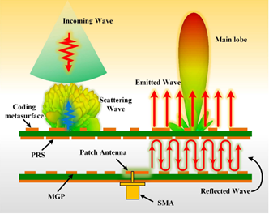
可编码超表面应用——天线
[16]
一维波导馈电超表面天线
[17]
基于衬底集成波导的超表面实现动态模式天线
[18]
基于双层可编码金属方形超表面法布里-珀罗天线

Slide 11
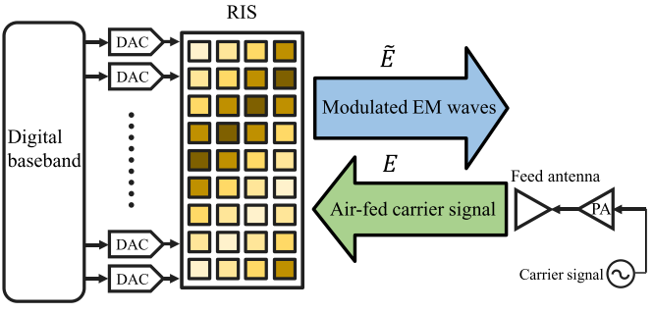
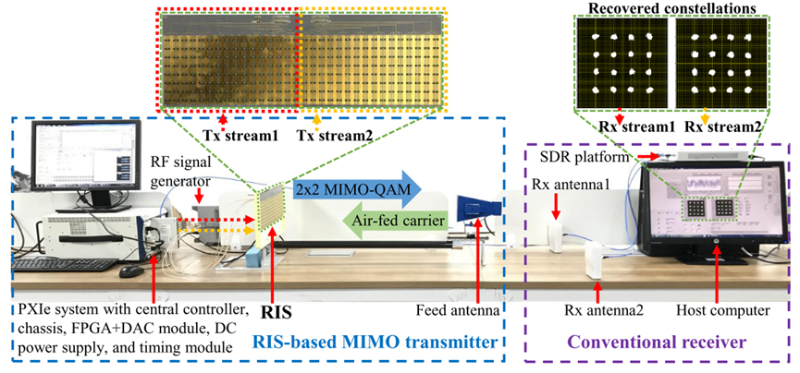
可编码超表面应用——发射器
[19]
频移键控
相移键控
正交幅度调制
变容二极管
数模转换器
窄带功率放大器

Slide 12
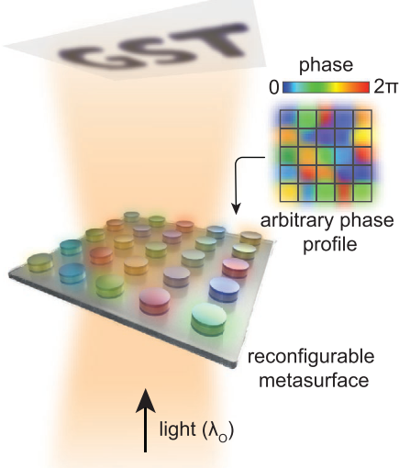
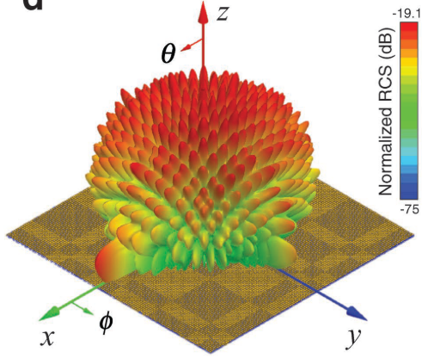
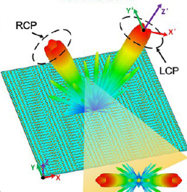
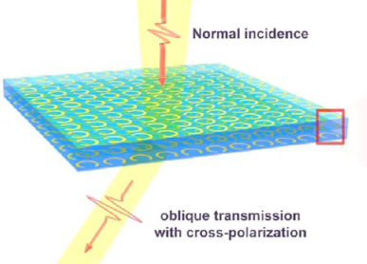
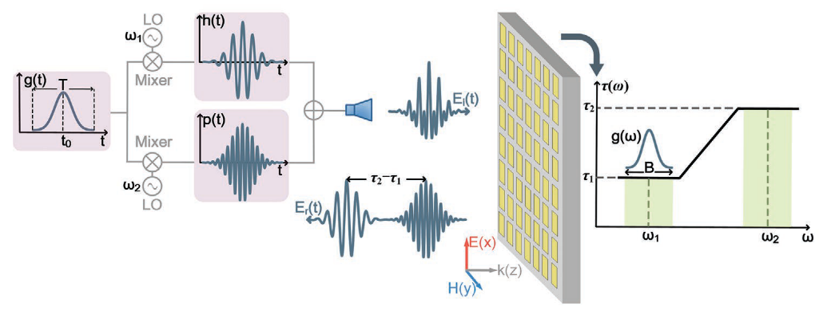
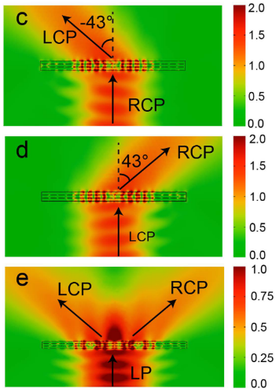
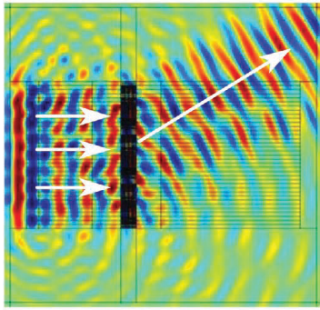
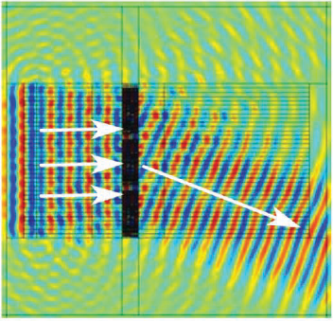
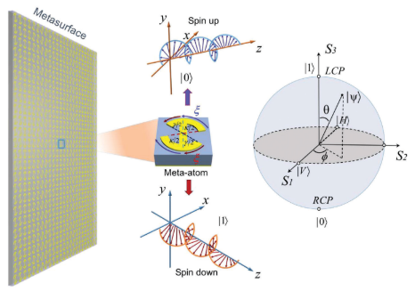
可编码超表面应用——奇异光学特性
异常反射
异常透射
编码成像
类漫反射
涡旋光束
光束弯曲
[20]
[4]
[13]
[11]
光分束
信号处理/模仿
偏振分束
频率选择
[22]
信号处理
[23]
模仿量子位
[14]
[21]

Slide 13
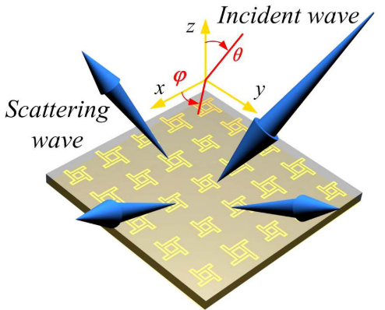
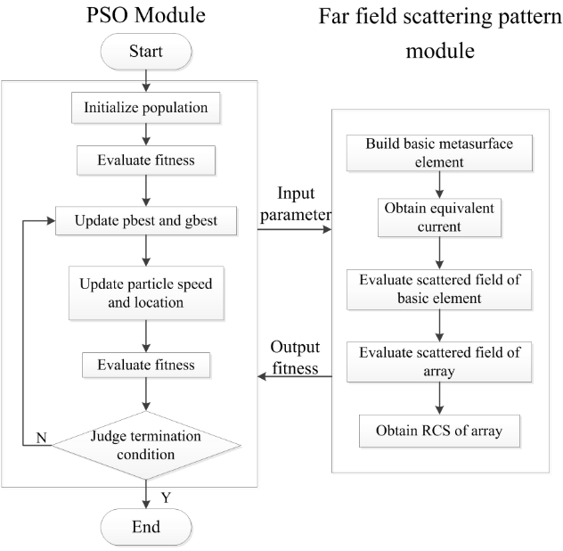
可编码超表面的新颖设计方法——演进类
优化对象：
算法流程：
优化目标：
宽频段的雷达横截面最小值
适应度计算方式：
等效电流法计算散射场模式
[24]

Slide 14
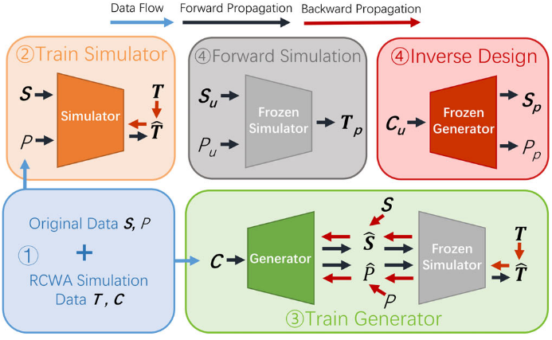
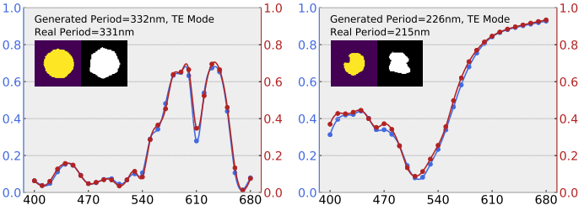
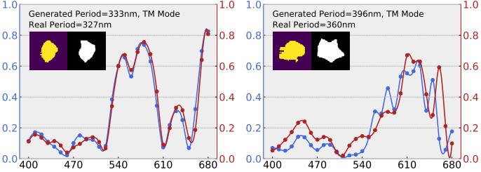
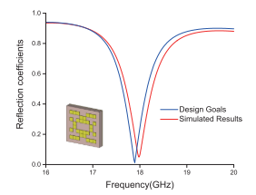
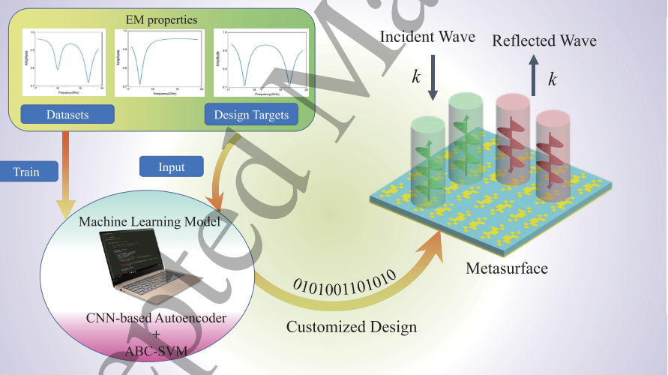
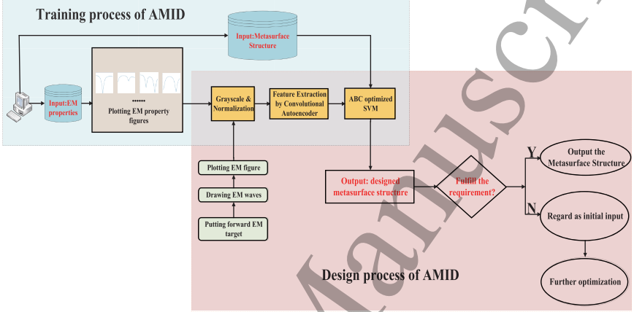

可编码超表面的新颖设计方法——建模类
设计单元结构：
[25]
设计编码序列：
[26]

Slide 15
References：
Veselago, V. G. (1968). The Electrodynamics of Substances with Simultaneously Negative Values of Img Align= Absmiddle Alt= ϵ Eps/Img and μ. Physics-Uspekhi, 10(4), 509-514.
Pendry, J. B., Holden, A., Stewart, W., & Youngs, I. (1996). Extremely low frequency plasmons in metallic mesostructures. Physical Review Letters, 76(25), 4773
Shelby, R. A., Smith, D. R., & Schultz, S. (2001). Experimental verification of a negative index of refraction. Science, 292(5514), 77-79.
Cui, T. J., Qi, M. Q., Wan, X., Zhao, J., & Cheng, Q. (2014). Coding metamaterials, digital metamaterials and programmable metamaterials. Light: Science & Applications, 3(10), e218-e218.
Zhang, L., Liu, S., Li, L., & Cui, T. J. (2017). Spin-controlled multiple pencil beams and vortex beams with different polarizations generated by Pancharatnam-Berry coding metasurfaces. ACS applied materials & interfaces, 9(41), 36447-36455.
Chen, K., Feng, Y., Yang, Z., Cui, L., Zhao, J., Zhu, B., & Jiang, T. (2016). Geometric phase coded metasurface: from polarization dependent directive electromagnetic wave scattering to diffusion-like scattering. Scientific reports, 6(1), 1-10.
Ding, X., Monticone, F., Zhang, K., Zhang, L., Gao, D., Burokur, S. N., . . . Alù, A. (2015). Ultrathin Pancharatnam–Berry metasurface with maximal cross‐polarization efficiency. Advanced Materials, 27(7), 1195-1200.
Xu, H.-X., Liu, H., Ling, X., Sun, Y., & Yuan, F. (2017). Broadband vortex beam generation using multimode Pancharatnam–Berry metasurface. IEEE Transactions on Antennas and Propagation, 65(12), 7378-7382.
Pfeiffer, C., & Grbic, A. (2013). Metamaterial Huygens’ surfaces: tailoring wave fronts with reflectionless sheets. Physical Review Letters, 110(19), 197401.
Guan, C., Wang, Z., Ding, X., Zhang, K., Ratni, B., Burokur, S. N., . . . Wu, Q. (2019). Coding Huygens’ metasurface for enhanced quality holographic imaging. Optics Express, 27(5), 7108-7119.
Leitis, A., Heßler, A., Wahl, S., Wuttig, M., Taubner, T., Tittl, A., & Altug, H. (2020). All‐Dielectric Programmable Huygens' Metasurfaces. Advanced Functional Materials, 30(19), 1910259.
Wong, A. M., & Eleftheriades, G. V. (2018). Perfect anomalous reflection with a bipartite Huygens’ metasurface. Physical Review X, 8(1), 011036.
Liu, S., Noor, A., Du, L. L., Zhang, L., Xu, Q., Luan, K., . . . Han, J. G. (2016). Anomalous refraction and nondiffractive Bessel-beam generation of terahertz waves through transmission-type coding metasurfaces. ACS Photonics, 3(10), 1968-1977.

Slide 16
References：
Liu, C., Bai, Y., Zhao, Q., Yang, Y., Chen, H., Zhou, J., & Qiao, L. (2016). Fully controllable Pancharatnam-Berry metasurface array with high conversion efficiency and broad bandwidth. Scientific reports, 6, 34819.
Yu, N., Genevet, P., Aieta, F., Kats, M. A., Blanchard, R., Aoust, G., . . . Capasso, F. (2013). Flat optics: controlling wavefronts with optical antenna metasurfaces. IEEE Journal of Selected Topics in Quantum Electronics, 19(3), 4700423-4700423.
Smith, D. R., Yurduseven, O., Mancera, L. P., Bowen, P., & Kundtz, N. B. (2017). Analysis of a waveguide-fed metasurface antenna. Physical Review Applied, 8(5), 054048.
Li, S., Xu, F., Wan, X., Cui, T. J., & Jin, Y.-Q. (2020). Programmable Metasurface Based on Substrate-Integrated Waveguide for Compact Dynamic-Pattern Antenna. IEEE Transactions on Antennas and Propagation.
Zhang, L., Wan, X., Liu, S., Yin, J. Y., Zhang, Q., Wu, H. T., & Cui, T. J. (2017). Realization of low scattering for a high-gain Fabry–Perot antenna using coding metasurface. IEEE Transactions on Antennas and Propagation, 65(7), 3374-3383.
Tang, W., Dai, J. Y., Chen, M. Z., Wong, K.-K., Li, X., Zhao, X., . . . Cui, T. J. (2020). MIMO transmission through reconfigurable intelligent surface: System design, analysis, and implementation. IEEE Journal on Selected Areas in Communications.
Moccia, M., Liu, S., Wu, R. Y., Castaldi, G., Andreone, A., Cui, T. J., & Galdi, V. (2017). Coding metasurfaces for diffuse scattering: scaling laws, bounds, and suboptimal design. Advanced Optical Materials, 5(19), 1700455.
Rong, J., Ye, W., Zhang, S., & Liu, Y. (2020). Frequency‐Coded Passive Multifunctional Elastic Metasurfaces. Advanced Functional Materials, 2005285.
Chen, M. Z., Cheng, Q., Xia, F., Rashid, A. K., Dai, J. Y., Zhang, C., . . . Cui, T. J. (2020). Metasurface‐Based Spatial Phasers for Analogue Signal Processing. Advanced Optical Materials, 8(18), 2000128.
Bai, G. D., & Cui, T. J. (2020). Representing Quantum Information with Digital Coding Metasurfaces. Advanced Science, 7(20), 2001648.
Wang, K., Zhao, J., Cheng, Q., & Cui, T. J. (2014). Broadband and broad-angle low-scattering metasurface based on hybrid optimization algorithm. Scientific reports, 4, 5935. Wang, K., Zhao, J., Cheng, Q., & Cui, T. J. (2014). Broadband and broad-angle low-scattering metasurface based on hybrid optimization algorithm. Scientific reports, 4, 5935.
Han, X., Fan, Z., Liu, Z., Li, C., & Guo, L. J. (2020). Inverse design of metasurface optical filters using deep neural network with high degrees of freedom. InfoMat.
Shi, X., Qiu, T., Wang, J., Zhao, X., & Qu, S. (2020). Metasurface inverse design using machine learning approaches. Journal of Physics D: Applied Physics, 53(27), 275105.

Slide 17
谢谢

